Slide 1

MongoDB Workshop for AXA
Day 1
21 Sept 2016
Hong Kong

Slide 2

Day 1
MongoDB Enterprise
MongoDB architecture
MongoDB on OpenShift
Integration with 3rd party tools
Agenda

Slide 3












MongoDB Inc,
600+ employees
2500+ customers
Offices in NY, London & Palo Alto and
across EMEA, and APAC
World Class Advisory

Slide 4
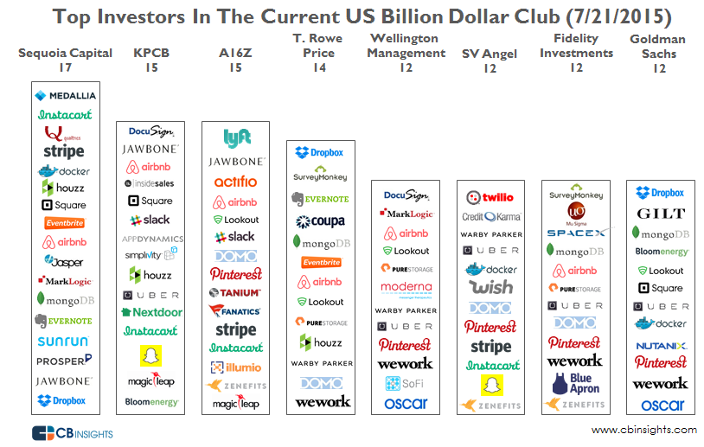


Slide 5

Forrester Wave™:
Big Data NoSQL, Q3 2016
August 2016

Slide 6
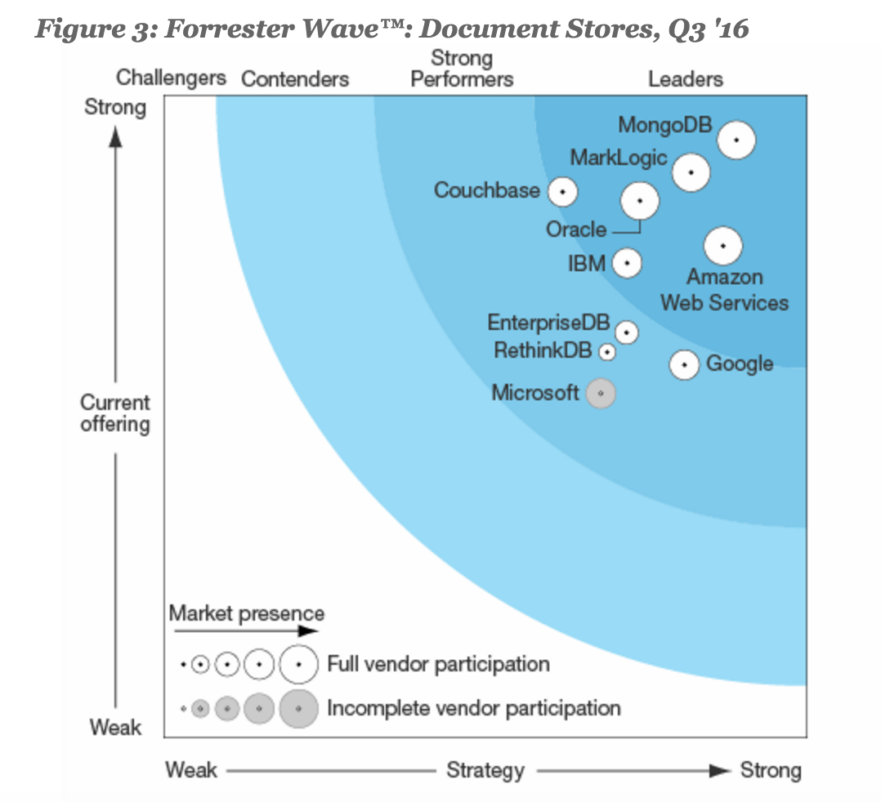
Forrester Wave™:
Document Stores, Q3 2016
September 2016

Slide 7
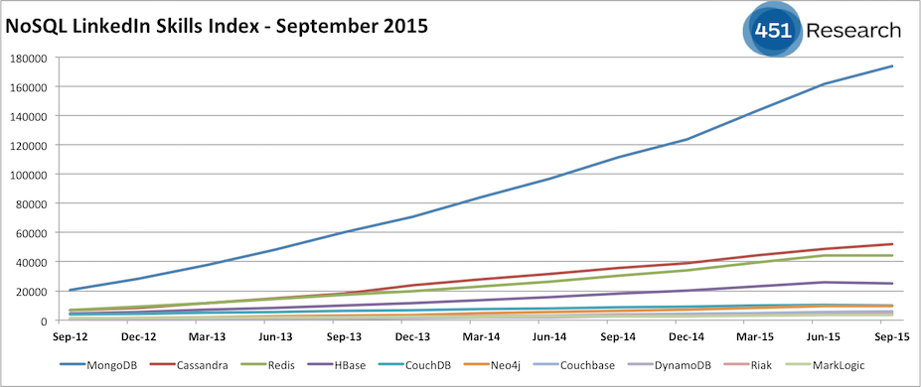
451 Group: Skills Availability
“there is only one trend:
the total dominance of MongoDB”
https://blogs.the451group.com/information_management/2015/10/01/nosql-linkedin-skills-index-september-2015/
Notes:
Access to a greater pool of skills means its easier to staff project – build apps faster, at lower cost and risk

Slide 8









MongoDB Ecosystem – 900+ Partners
Software & Services
Cloud & Channel
Hardware

Slide 9









Analytics & BI Partners

Slide 10
Day 1
MongoDB Enterprise
MongoDB architecture
MongoDB on OpenShift
Integration with 3rd party tools
Agenda

Slide 11
Day 1
MongoDB Enterprise
MongoDB architecture
MongoDB on OpenShift
Integration with 3rd party tools
Agenda

Slide 12
Day 1
MongoDB Enterprise
MongoDB architecture
MongoDB on OpenShift
Integration with 3rd party tools
Agenda

Slide 13

{
name : “Gabriel Woo”,
title : “Enterprise Account Executive”,
mail : “gabriel.woo@mongodb.com”,
phone : “+852 9262 1387”,
location : “Hong Kong, HKG”
}
{
name : “TJ Tang”,
title : “Senior Solution Architect”,
mail : “jianfa.tang@mongodb.com”,
phone : “+852 6611 6526”,
location : “Hong Kong, HKG”
}

